Slide 1

Language Translator Project
Topic : Currency Convertor
Name: Panchal Chetan S.
Roll No: IT059
Name: Madhav Pandya
Roll No: IT060

Slide 2
1. In our language our main aim is conversion of currency, i.e currency of one country can be converted into others and vice versa. 2. Our language would be easily understandable as we have used human friendly and easily readable language. 3. Here for conversion we have taken five countries namely India, US, China, Europe and UK and their respective currencies are Rupees, Dollar, Yuan, Euro and Pound respectively. 4. You just need to type your input like e.g Find <indicated letter for respective country> to <conversion country> <<Value to be converted>>
Description

Slide 3
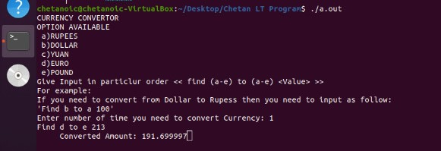
Output 1:

Slide 4
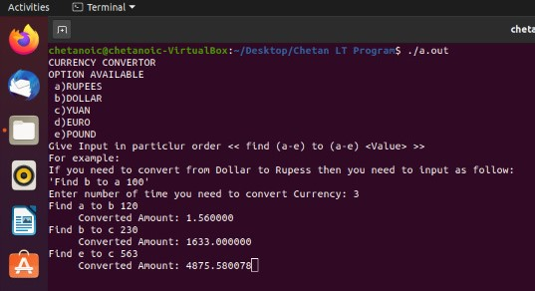
Output 2:

Slide 5
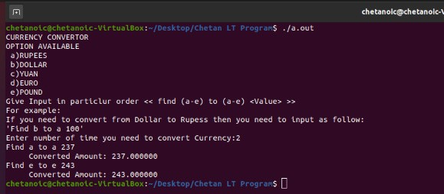
Output 3:

